Slide 1
Data Science Lab - Assessment
Airbnb listing price model

Slide 2



Introduction

Slide 3



Introduction

Slide 4
Assessment details
“Predict the price of a new Airbnb listing”
22,552 records
96 columns
Approach
Step 1 – Online research
Step 4 – Variable elimination
Step 2 – Exploratory data analysis
Step 5 – Regression Modeling
Step 3 – Data processing & enhancing
Step 6 – Model assessment

Slide 5
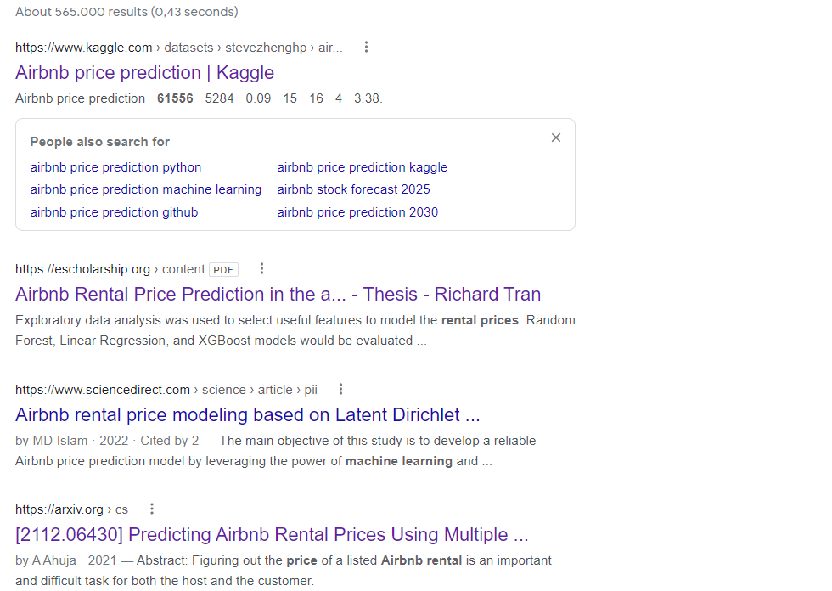
Step 1 – Online research
Plenty of information online
Linear Regression
XGBoost
Ridge Regression

Slide 6
Step 1 – Online research
Plenty of information online
Linear Regression
XGBoost
RidgeRegression
Try a naive model as reference
Complexity later

Slide 7
Step 2 – Exploratory data analysis
96 columns - Dependent variable Price
Data type | Character | Categorical | Logical | Integer | Numerical | Date
# of columns | 20 | 14 | 9 | 21 | 10 | 4

